Slide 1
Chapter - Text Classification
From the book Hands-On Large Language Models

Slide 2
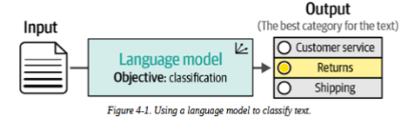
What is Text Classification?
Common applications:
Sentiment analysis (positive/negative)
Intent detection (what does the user want?)
Entity extraction (finding names, places, etc.)
Language detection

Slide 3
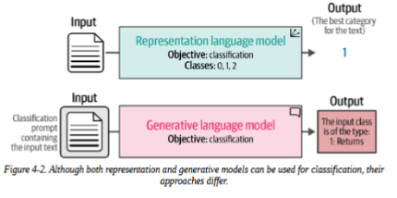
What is Text Classification?
This chapter covers two main approaches:
Representation models (BERT-like) - output class directly
Generative models (GPT-like) - output text that we parse into classes

Slide 4
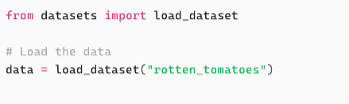
What is Text Classification?
The Dataset - Rotten Tomatoes movie review dataset:
5,331 positive reviews
5,331 negative reviews
Binary classification task (positive vs negative)
Loading the data:

Slide 5
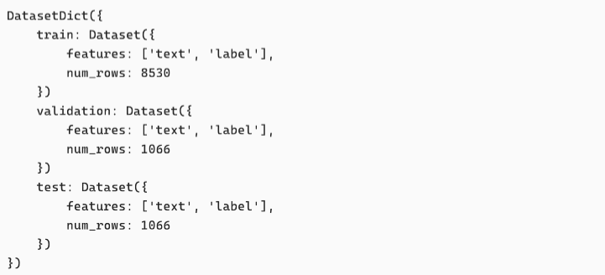
What is Text Classification?
The previous code outputs:
As you can see above, the data is split into train, test, validation splits.

Slide 6

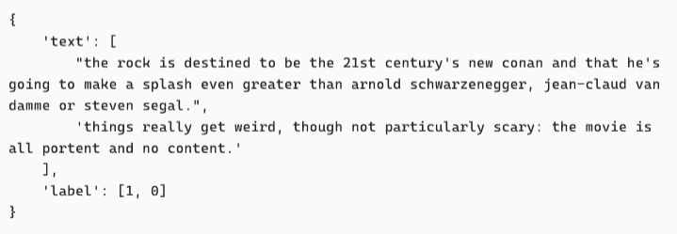
What is Text Classification?
Let’s take a look into the content of the dataset:
This outputs:

Slide 7
Text Classification with Representation Models
Representation models have 2 flavors:
Task-specific models - fine-tuned for one task (e.g., sentiment analysis)
Embedding models - generate general-purpose vectors you can use for anything

Slide 8
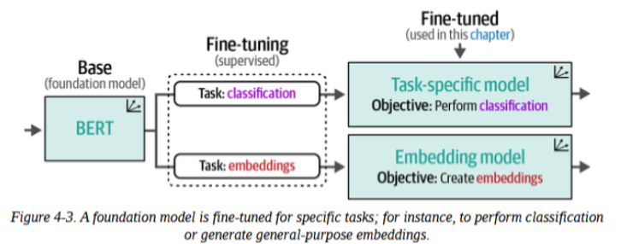
Text Classification with Representation Models
Representation models have 2 flavors:

Slide 9
Model Selection
Hugging Face Hub has more than 60,000 models for text classification over 8,000 models for generating embeddings.
Consider architecture, size, and language compatibility
Good baseline models to try:
bert-base-uncased (110M params)
roberta-base (125M params)
distilbert-base-uncased (66M params - faster)
microsoft/deberta-base (134M params)
bert-tiny
ALBERT base v2

Slide 10
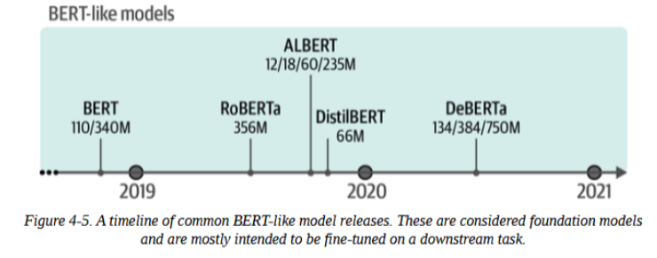
Model Selection
BERT variants over time:

Slide 11
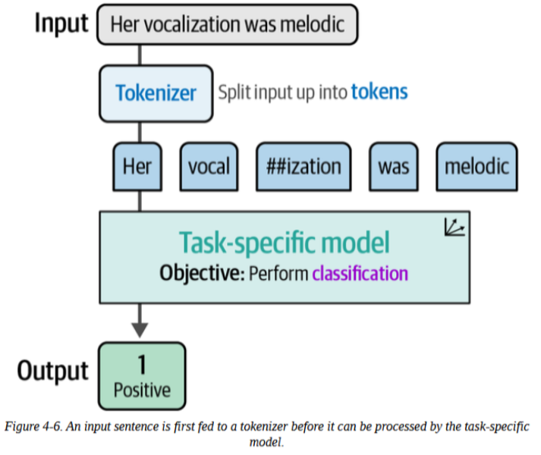
Using a Task-Specific Model
Task-specific models are the simplest approach. Load model, pass text, get prediction.

Slide 12
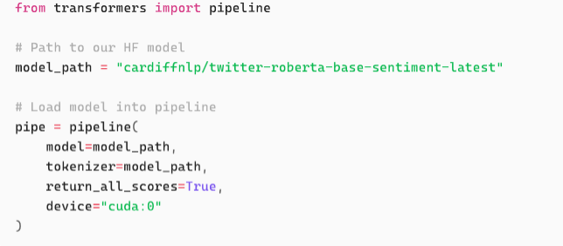
Using a Task-Specific Model
Loading the model:
As shown above, the tokenizer is loaded with the model. From Chapter 1, we know that a tokenizer is responsible for converting input text to tokens

Slide 13
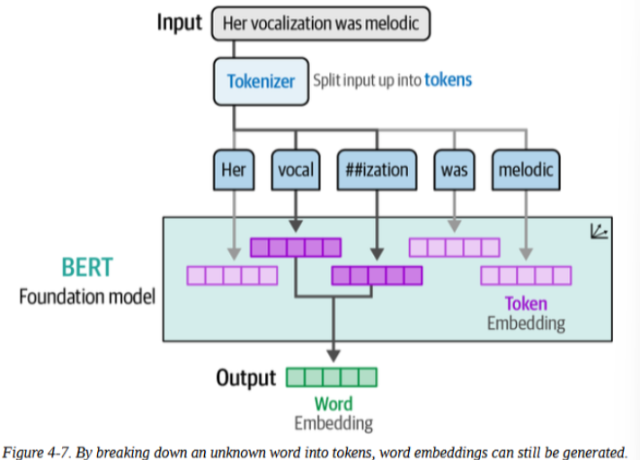
Using a Task-Specific Model

Slide 14
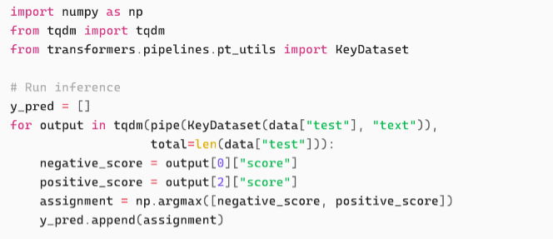
Using a Task-Specific Model
Running Inference:

Slide 15
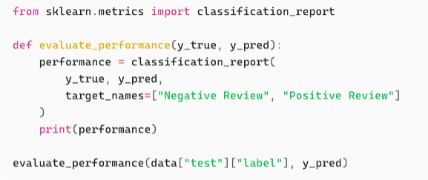
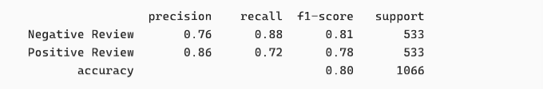
Using a Task-Specific Model
The next step after generating predictions is evaluation
The results are:

Slide 16
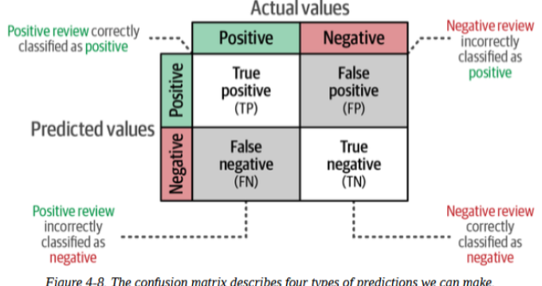
Using a Task-Specific Model
Key Metrics:
Precision - Of items we called positive, how many actually were?
Recall - Of all positive items, how many did we find?
F1 Score - Harmonic mean of precision and recall
Accuracy - Overall correctness (can be misleading with imbalanced classes)

Slide 17
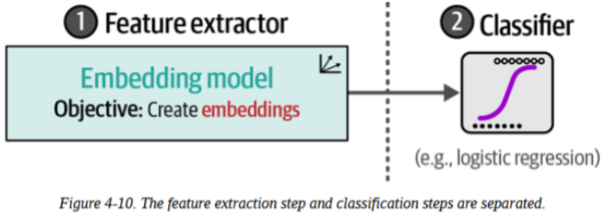
Classification Tasks That Leverage Embeddings
Supervised Classification:
Stage 1: Embedding model converts text to vectors (frozen, no training needed)
Stage 2: Simple classifier takes generated embeddings as input and (e.g., logistic regression) learns from those vectors (fast, runs on CPU)

Slide 18
Classification Tasks That Leverage Embeddings
Benefits of using a separate classifier:
No GPU needed for training - can be expensive and time-consuming
Embeddings work for any task - because the model is frozen, the model is not changed and stays the same as before, therefore, this model can be used for other tasks and in general. Can be attached to other classifiers for other specific tasks.
Lightweight classifier trains in seconds - e.g., logistic regression

Slide 19
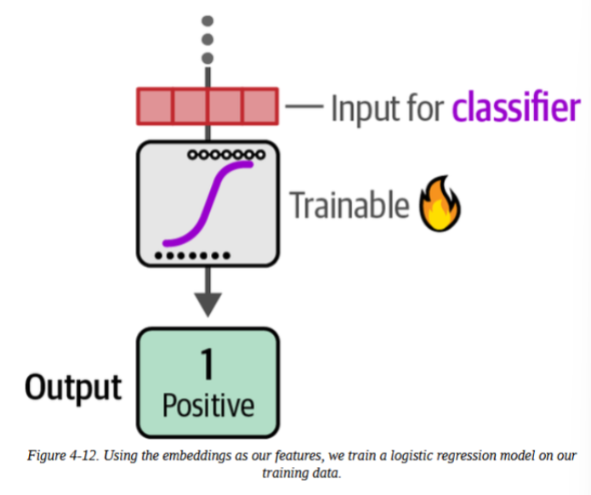
Classification Tasks That Leverage Embeddings
In the second step, these embeddings are the input features to the classifier illustrated:
In this example, we make it simple and use a logistic regression.

Slide 20
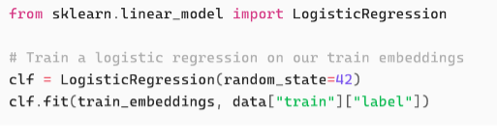
Classification Tasks That Leverage Embeddings
Train Classifier
To train the classifier, we need the embeddings from the frozen language model together with the labels

Slide 21
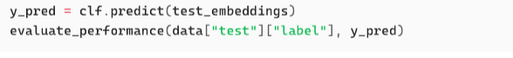
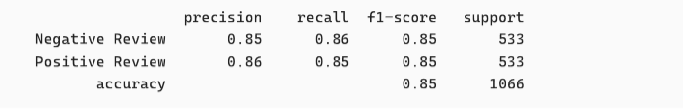
Classification Tasks That Leverage Embeddings
Train Classifier
Let's evaluate the trained model:
Results:
F1 score of 0.85, higher than a fine tuned model’s score we saw a few slides ago (0.80)
A higher score with just training a classifier

Slide 22
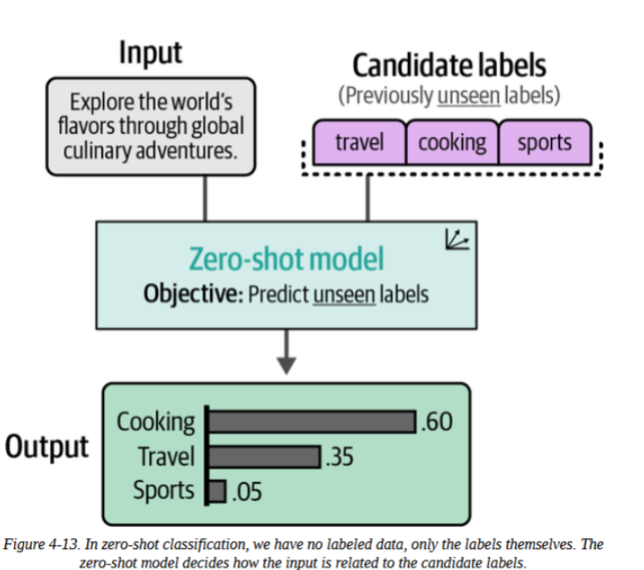
Zero-Shot Classification
In the previous example, we assume that there are labelled data to use for the classification. However, this is not always the case.
The solution to this is to use zero-shot classification: Describe your labels, embed them, find which label is most similar to each document.

Slide 23
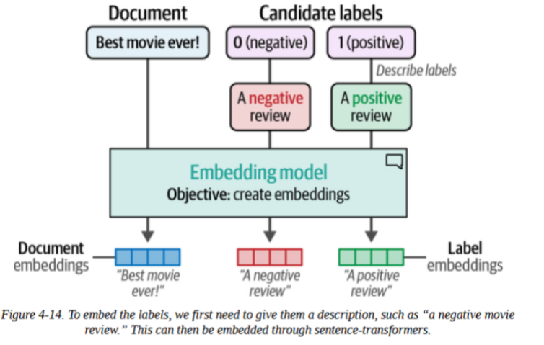
Zero-Shot Classification
Instead of using 0 or 1, we turn them into descriptions with semantic meanings.
Example: 0 (negative review), 1 (positive review)
Change 10-> “A negative review” , 1 -> “A positive review”
Tip: the more descriptive the better

Slide 24
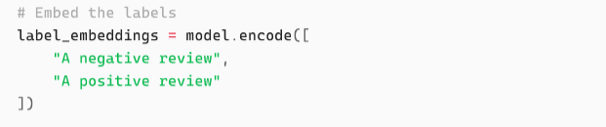
Zero-Shot Classification
Implementation:
We can create these label embeddings using the .encode function as we did earlier:

Slide 25
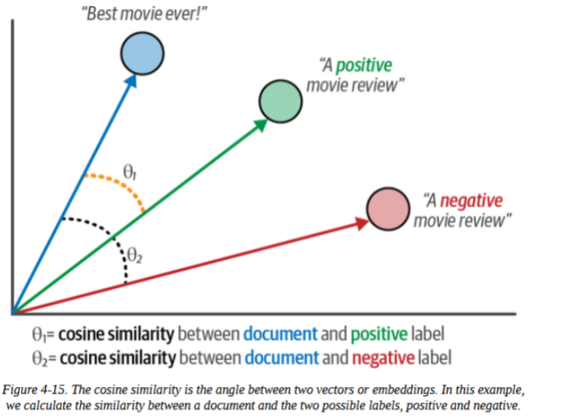
Zero-Shot Classification
We know for previous chapters that an embedding (vectors) corresponds to the coordinates of a document (text) in an embedding space.
Cosine similarity is the metric for this; it calculates the cosine of the angle between two vectors to see how closely they align in meaning.
Illustrated in the diagram.

Slide 26
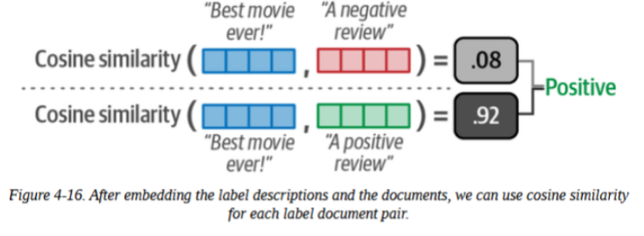
Zero-Shot Classification
Implementation:
We use cosine similarity to check how similar a given document is to the description of the candidate labels. The label with the highest similarity to the document is chosen.

Slide 27
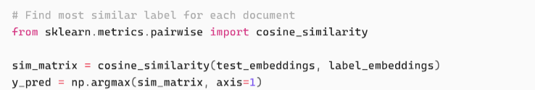
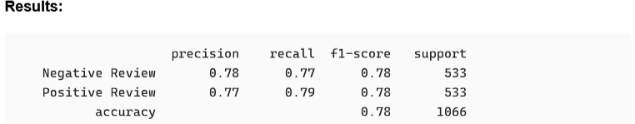
Zero-Shot Classification
We use cosine similarity to check how similar a given document is to the description of the candidate labels. The label with the highest similarity to the document is chosen.

Slide 28
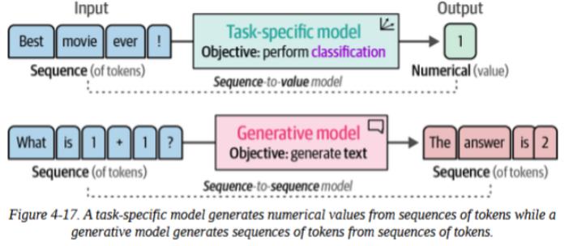
Text Classification with Generative Models
Unlike some representation models, generative models output text, not classes.

Slide 29
Text Classification with Generative Models
Key Differences
Task-specific: Text Input -> Classification prediction
Generative: Text Input + Prompt -> Generated Text -> Parse into class
Without a prompt, a generative model wouldn’t know what to do with a text.

Slide 30
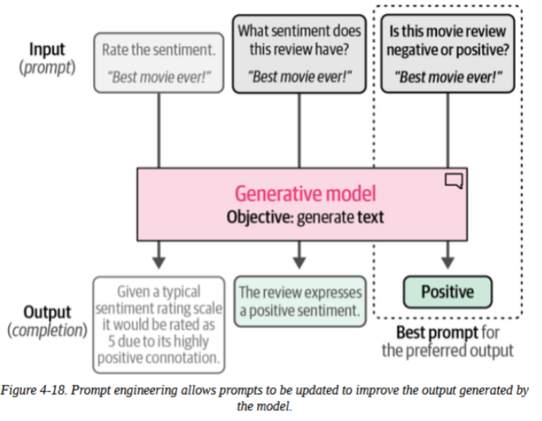
Text Classification with Generative Models
Key Differences
A generative model needs an instruction or prompt
The quality of your prompt matters a lot (as illustrated)

Slide 31
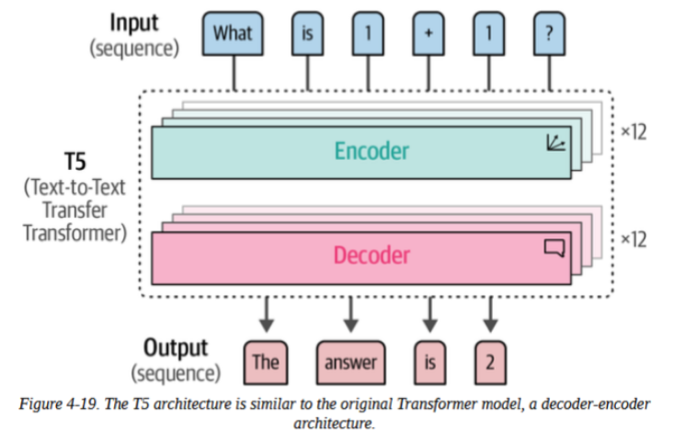
Using T5 (Text-to-Text Transfer Transformer)
Throughout the chapters we explored and the coming chapters, we mostly used encoder-only (representation) like BERT and decoder-only (generative) models like ChatGPT
T5 uses the original Transformer architecture: encoder + decoder. This falls in the category of generative models

Slide 32
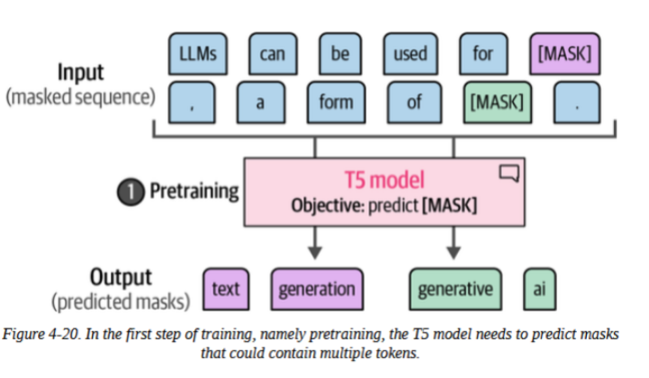
Using T5 (Text-to-Text Transfer Transformer)
How T5 Was Trained:
Step 1: Pretraining
Masked language modelling with token spans (not just single tokens).

Slide 33
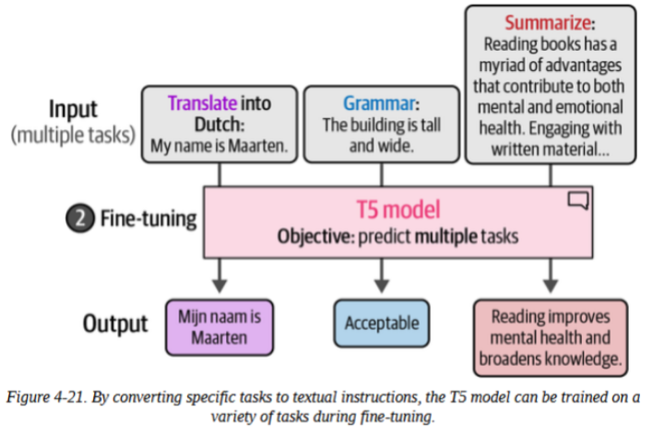
Using T5 (Text-to-Text Transfer Transformer)
How T5 Was Trained:
Step 2: Multi-task Fine-tuning
Trained on many tasks simultaneously by converting each to text-to-text format.
Flan-T5 variant: Fine-tuned on 1000+ tasks with better instruction following.

Slide 34
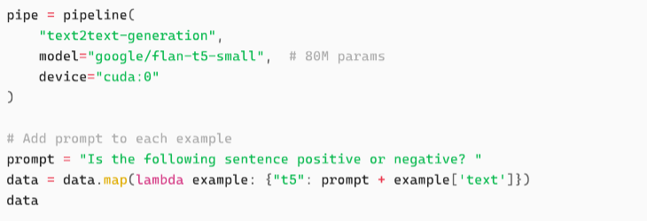
Using T5 (Text-to-Text Transfer Transformer)
Using Flan-T5

Slide 35
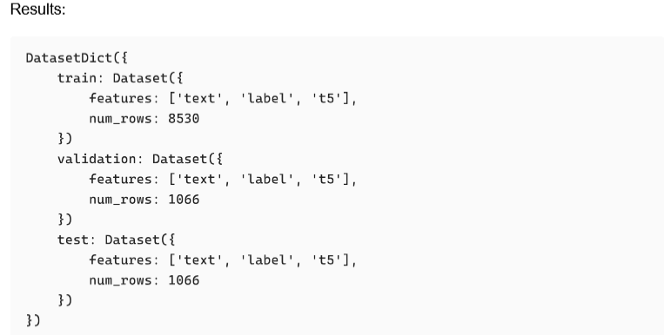
Using T5 (Text-to-Text Transfer Transformer)
Using Flan-T5

Slide 36
ChatGPT for Classification
Architecture and Training
Uses a decoder-only architecture based on GPT models.
Doesn’t share architectural details
The training process for ChatGPT involves two distinct phases:
Instruction Tuning
Preference Tuning
beyond the initial pretraining on large text corpora.
These phases differentiate ChatGPT from base GPT models.

Slide 37
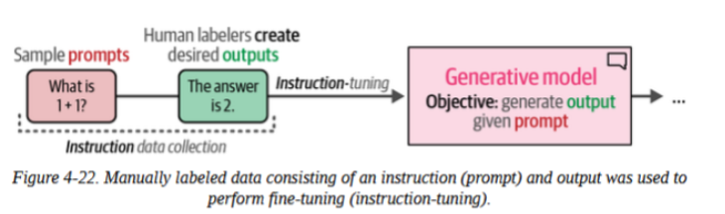
ChatGPT for Classification
Instruction Tuning
First phase
Also known as supervised fine-tuning.
Human annotators manually create datasets consisting of prompts paired with ideal responses
The base model is fine-tuned on these prompt-completion pairs.

Slide 38
ChatGPT for Classification
Instruction Tuning
This process teaches the model to understand and follow instructions
But it only capture what annotators think is good.
Doesn’t teach the model to select the most preferred output

Slide 39
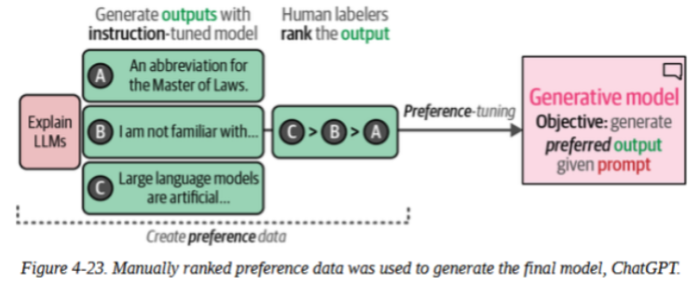
ChatGPT for Classification
Preference Tuning (RLHF)
The second phase addresses the limitation mentioned in the previous slide (about preference)
Implemented via Reinforcement Learning from Human Feedback (RLHF).

Slide 40
ChatGPT for Classification
Preference Tuning (RLHF)
The instruction-tuned model generates multiple candidate responses to the same prompt.
Human annotators rank these outputs from best to worst rather than writing ideal responses from scratch (see diagram).

Slide 41
ChatGPT for Classification
Preference Tuning (RLHF)
By showing the model the difference between acceptable and excellent responses, it learns to generate outputs that better align with human expectations and preferences.
This is why ChatGPT tends to produce more helpful, harmless, and honest responses

Slide 42
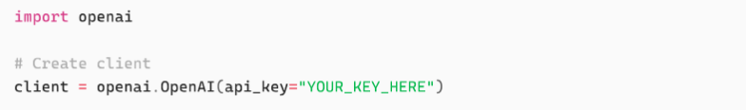
ChatGPT for Classification
Implementation with OpenAI API
First, create an account at platform.openai.com and generate an API key from the API keys section.
The free tier includes initial credits that should be sufficient for experimentation.

Slide 43
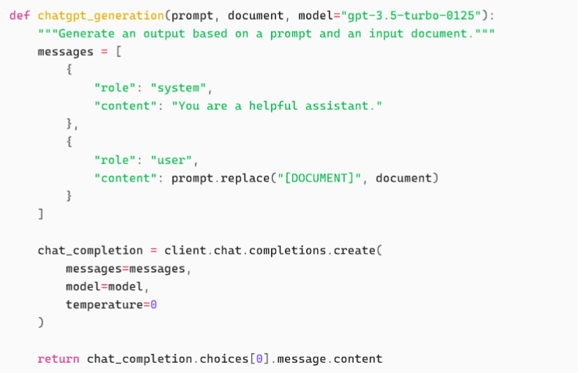
ChatGPT for Classification
Creating a Generation Function
We'll create a wrapper function that handles the API interaction:
system : Sets the assistant's behavior and context
user: Contains the actual prompt with our classification request

Slide 44
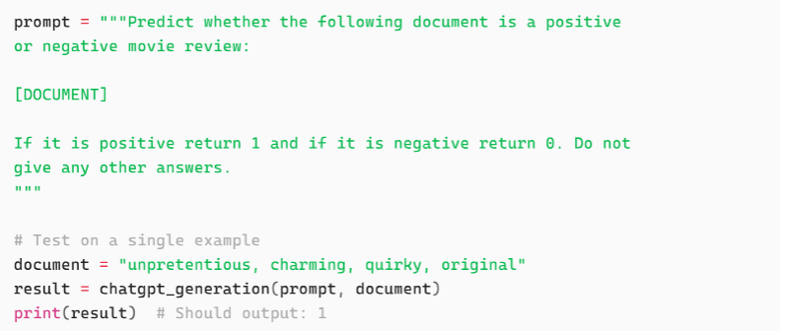
ChatGPT for Classification
Prompt Design
Unlike task-specific models where the task is baked into the weights, generative models need explicit instructions

Slide 45
ChatGPT for Classification
Prompt Design
The prompt structure matters significantly:
Clear task description ("Predict whether...")
Explicit output format ("return 1 or 0")
Constraint on output space ("Do not give any other answers")
Poorly designed prompts will lead to inconsistent outputs that are harder to parse programmatically.

Slide 46
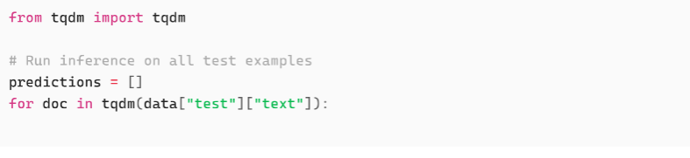
ChatGPT for Classification
Batch Inference
To evaluate on the full test set:

Slide 47
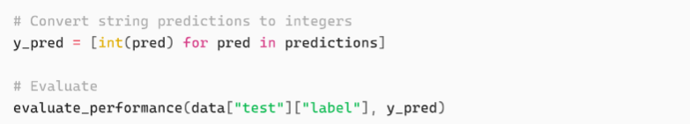
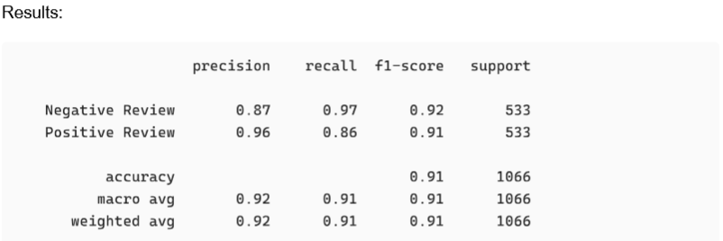
ChatGPT for Classification
Batch Inference

Slide 48
ChatGPT for Classification
Practical Considerations
Cost Tracking
For our test set of 1,066 reviews using gpt-3.5-turbo-0125, the cost is approximately $0.03 at current pricing
A production system processing millions of documents would incur substantial expenses.
Rate Limiting
APIs have rate limits to prevent abuse and ensure fair resource allocation.
When you hit a rate limit, the API returns a 429 status code.

Slide 49
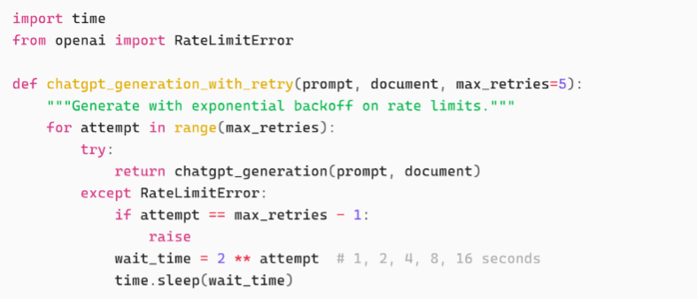
ChatGPT for Classification
Practical Considerations
Rate Limiting
The proper handling approach is exponential backoff:

Slide 50
ChatGPT for Classification
Practical Considerations
Data Privacy
Training data usage: OpenAI's API terms specify whether your data can be used for model training. As of the latest terms, data sent through the API is not used for training by default, but verify current policies.
Sensitive information: Never send personally identifiable information, proprietary data, or confidential information through external APIs without proper data agreements,
Geographic restrictions: Some jurisdictions have data residency requirements that prohibit sending data to foreign servers

Slide 51
END

